Slide 1

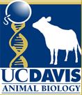
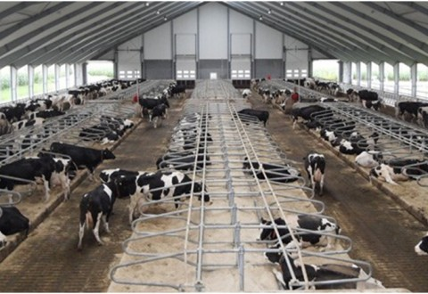
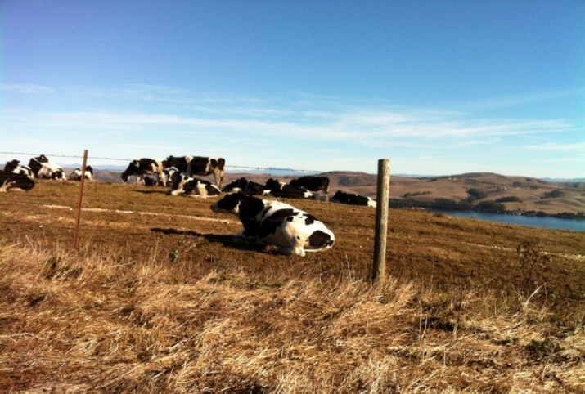
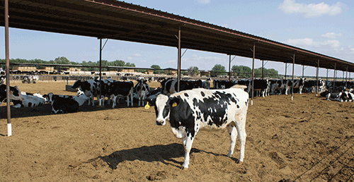


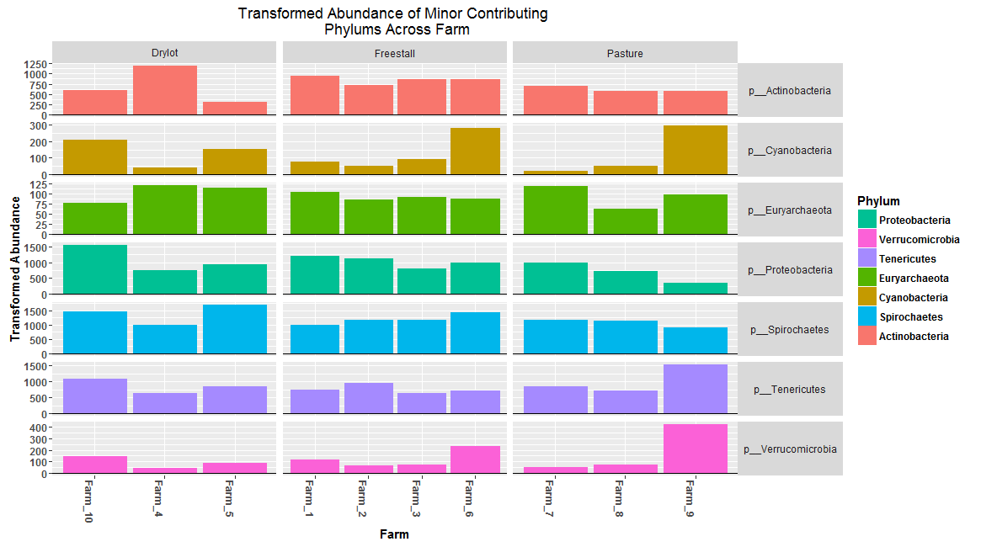
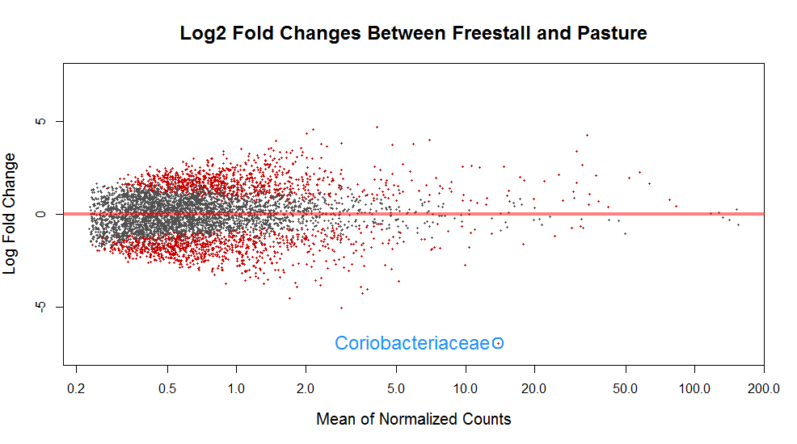
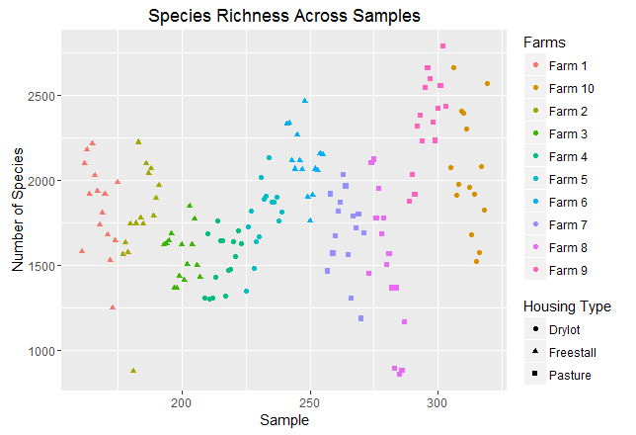
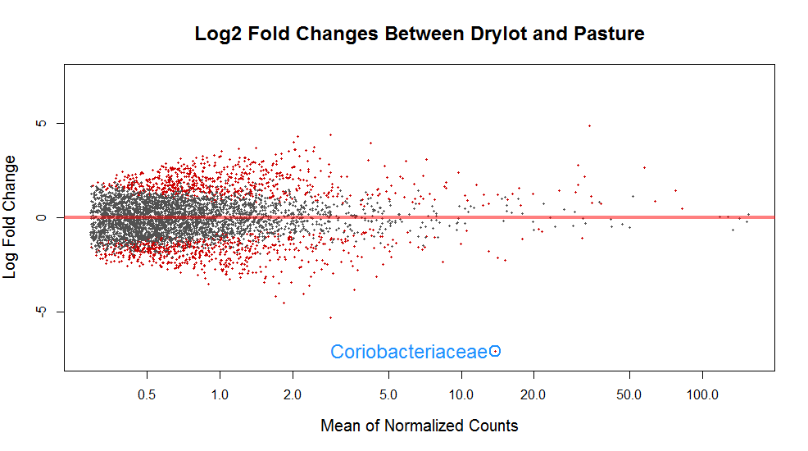
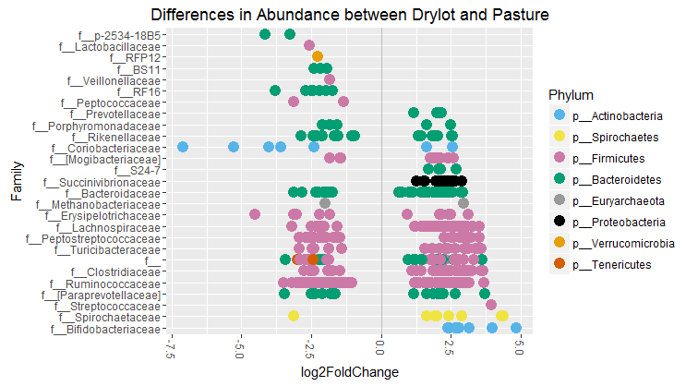
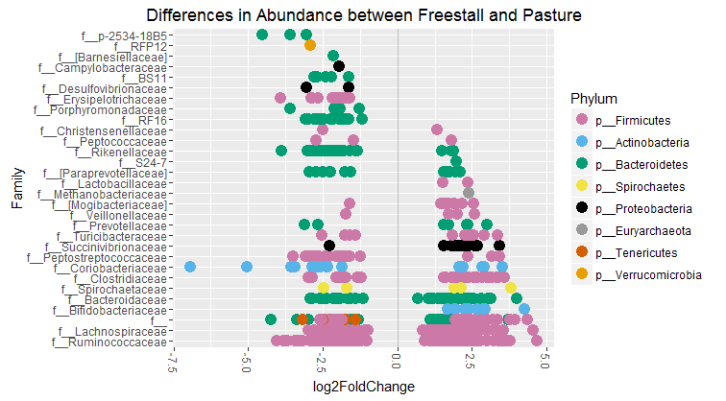
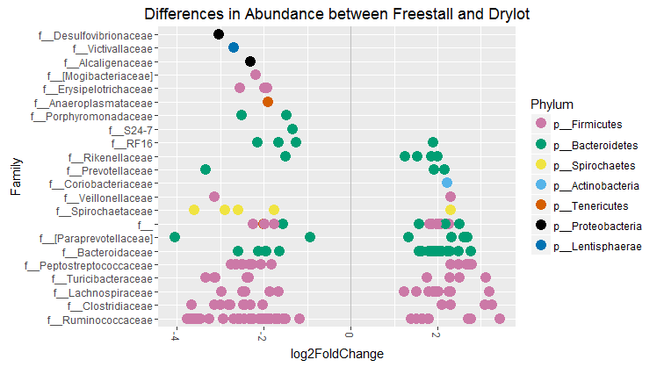
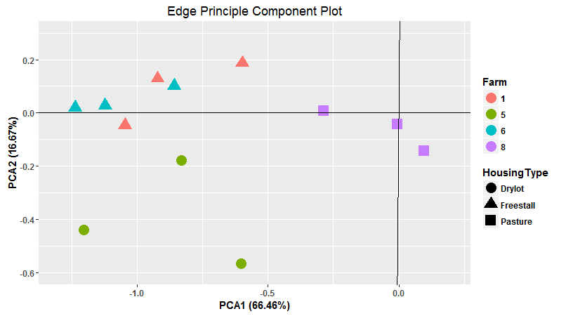
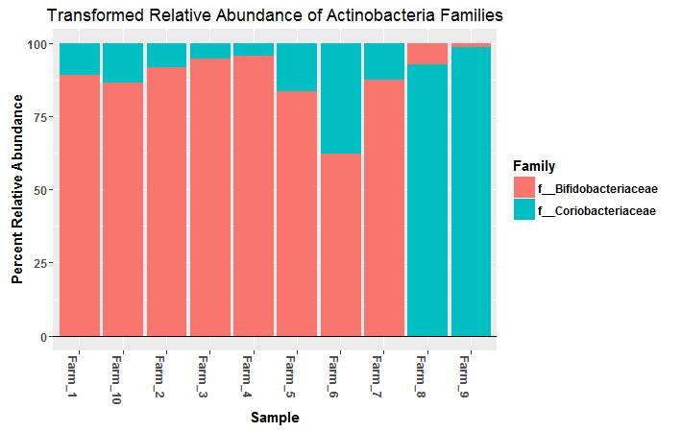
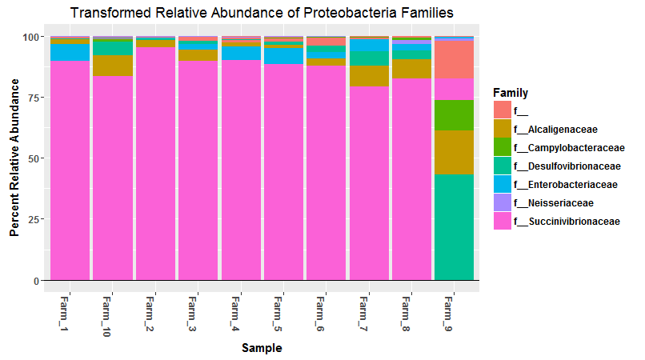
Survey of Microbial Fecal Populations Across California Dairies
Jill V. Hagey, Deanne Meyer and Elizabeth A. Maga
Department of Animal Science, University of California, Davis
This project was funded by California Dairy Research Foundation (CDRF) Project Number P-15-004-UCD-DM-SUST
Introduction
Nitrogen waste management has become crucial with intensification of livestock production as it is of environmental and economic interest. Nitrogen is the most expensive element to balance in rations and high levels are required for peak performance. However, excess nitrogen is secreted in urine and feces contributing to global warming through volatile emissions of nitric oxide (N₂O) and ammonia (NH₃) and eutrophication by leaching of nitrate into ground water (NO₃⁻). The microbiome plays a critical role in nitrogen cycling in ruminants. Increased access to next generation sequencing has allowed better resolution of these communities, however, the field lacks a robust analysis surveying common microbial populations and their metabolic functions in cattle. This surveys is one of the first to determine the composition and functional capacity of the microbiome of dairy cattle on commercial operations across northern/central California. Ten farms representing a variety of feeding and management systems were enrolled. Metagenomic and 16S amplicon data was analyzed from fecal samples that were collected from 15 cows from each farm over a seven month period. The goal of this survey is to clarify normal microbial communities and their contributions to nitrogen cycling in dairy cattle. This data will further generate hypothesis for strategies that target the microbiota to increase nitrogen mineralization and reduce environmental impact of dairies. The first step of this survey was determining the make-up of species and their variation across farm.
Experimental Design
Drylots
Housing Types
Freestalls
Analysis:
Functional Profiling (HUMAnN2)
Reference Based Taxonomy (Kaiju and Kraken)
Phylogenetic Based Taxonomy (Phylosift)
Assembly of Genomes (MEGAHIT)
Counting Genes of Interest (Hmmer/Diamond)
Pastures
Metagenomic
Sequencing
Quality Filtering:
Merging
Trimming
3 Farms
3 Farms
4 Farms
DNA
Extraction
16S rRNA
Amplicon
Sequencing
Quality Filtering:
Merging
Trimming
Off Target Reads
Chimeras
de novo OTU Picking
Analysis in R:
Phyloseq
DESeq2
15 cows per farm
Species Richness Significantly Different Across Farms
Phylum Variation Across Farms
Coriobacteriaceae Significantly Decreased on Non-Pasture
A
B
Figure 1: 16S rRNA amplicon paired-end sequences were trimmed for quality and length, Phix174 and chimeric reads removed and QIIME was used for de novo OTU picking and analysis of species richness (SR) across samples. There was no effect of housing type on SR, but there was a significant effect of farm as measured by Kruskal-Wallis rank sum test. P-value of <0.01 was considered significant.
Figure 2: Firmicutes and Bacteroidetes were the dominant phylum across farms with average relative abundances of 61.28% ± 0.03 and 27.57% ± 0.04 respectively. Proteobacteria, Actinobacteria, Fibrobacteres, Tenericutes, Spirochaetes. Verrucomicrobia, Cyanobacteria and Euryarchaeota were all minor contributors with average relative abundances below 0.002%. Planctomycetes, Lentisphaerae, Elusimicrobia and Fibrobacteres were all low abundance phylums not present on all farms.
Figure 3: Transformed OTU counts were determined to account for differences in library size using a negative binomial generalized linear model in the DEseq2 Package in R. Log fold changes of bacteria counts between (A) Pasture compared to Freestall systems and (B) Pasture compared to Drylot housing. Significantly changed OTU counts are shown in red determined by p ≤ 0.01. The most significantly changed OTU showed a decrease in Coriobacteriaceae for both non-pasture systems compared to pasture.
Fold Changes in Abundance of Bacterial Families When Comparing Housing Types
PCoA of Phylogentic Taxonomic Assignment
A
B
C
Bifidobacteriaceae_F
Clostridales_C
Bacteroidales_O
*
Spirochaetaceae_F
Methanobacteriaceae_F
Clostridiaceae_F
Peptostreptococcaceae_F
Mollicutes_C
*
*
*
*
*
Methanobacteriaceae_F
(2) Clostridales_C
Bifidobacteriaceae_F
Spirochaetaceae_F
Clostridales_C
Prevotellaceae_F
Figure 4: 16S amplicon paired-end reads were merged, trimmed for quality and length, Phix174 and chimeric reads removed. QIIME was used for de novo OTU picking. Transformed OTU counts were determined to account for differences in library size using a negative binomial generalized linear model in the DEseq2 Package in R. Significant log fold-changes of bacteria family counts between (A) Drylot and Pasture (B) Freestall and Pasture and (C) Freestall and Drylot are presented. Notable, common fold-changes for both Freestall and Drylot compared to Pasture denoted with *. Adjusted P <0. 01 considered significant.
Figure 5: Quality filtered and merged pair metagenomic reads were assigned phylogenic assignments with PhyloSift and ordination taking into account phylogenetic structure was calculated with Guppy and plotted in a PCA plot in R. Specific taxa contributing to PCA1 and 2 are present at highest level of classification.
Relative Abundance of Bifidobacteriaceae and Coriobacteriaceae Varies by Farm
Relative Abundance of Proteobacteria Across Farms
Conclusions
Based on 16S data, abundances of Firmicutes and Bacteroidetes were consistent across farms and minor contributing phyla showed variation.
Strictly Pasture fed animals had greater diversity of Proteobacteria families characterized by a decrease in Succinivibrionaceae and increases in Camplylobacteraceae and Desulfovibrionaceae.
The data shows a difference in the ratio Bifidobacteriaceae compared to Coriobacteriaceae across farms.
Figure 6: OTU counts were transformed to account for differences in library size with a negative binomial generalized linear model in the R package DEseq2. Bar graph made with the Phyloseq R package. Two out of three pasture-based farms had a decreased abundance of Bifidobacteriaceae compared to Coriobacteriaceae while the other had the reverse mirroring a majority of the other farms. Farm 6 had a relatively even split of both families.
Figure 7: Transformed OTU counts to account for differences in library size were determined with a negative binomial generalized linear model in the R package DEseq2. Bar graph made with the Phyloseq R package. Farm 9 that was strictly pasture based had the lowest abundance of Succinivibrionaceae and the highest amount Camplylobacteraceae and Desulfovibrionaceae. These changes were not seen on Farm 7 and 8 which are pasture based as well, but do receive grain supplementation.
Future Directions
Determine functional differences using metagenomics analysis
Determine major bacterial contributors to nitrogen cycling
Investigate variations in antibiotic resistance across farms
Investigate metabolic consequences of a difference in the ratio of Bifidobacteriaceae to Coriobacteriaceae
Determine metabolic outcomes of increases of Desulfovibrionaceae and decreases in Succinivibrionaceae

